Slide 1
CFPS和PSID SES常用变量总结

Slide 2
CFPS和PSID被试群体
CFPS和PSID均以家庭为单位，在同一家庭中，可能调查不只一代（甚至两代）人的信息，而不同的人群（如儿童/成年人），调查的题目也是不同的
对于被试的SES信息，可能有不同的来源
CFPS:
对于成年人：成年人问卷条目；家庭问卷条目
对于未成年人：儿童问卷条目；家庭问卷条目；父母的成年人问卷条目→因此儿童的父母SES信息会更加完整
*由于我们将儿童设置为10-22岁,和CFPS中10-15岁的儿童问卷施测年龄不同,因此部分儿童也有成年人问卷条目

Slide 3
CFPS和PSID被试群体
PSID:和CFPS类似,但PSID家庭结构更复杂,可以根据relation将成员分为Reference person(rp),spouse(sp),rp和sp的子女,等其他很多类型的成员,其中rp,sp及其子女(relation = 10, 20,30)这三类对我们最为重要
Rp和sp有单独的问卷因此有一些附加的信息,同时也有每个被试均有的个体问卷
我们也将儿童设置为10-22岁, 因此儿童也有可能为rp/sp,当我们需要用rp/sp的变量作为儿童父母的变量时 (sss_rp, sss_sp),需要首先选择儿童的relation为rp/sp的子女的个体(relation ==30)
对于通过pid_f和pid_m识别的父母的变量(edu),则不需要儿童的relation是rp/sp
同样,成年人也不一定为rp/sp,因此对于rp/sp的变量,只有relation为rp/sp的被试可以使用
以上这些信息已经在数据中进行合并，我们在复现的过程中仅需要根据原文信息，选择对应群体的数据库即可

Slide 4
收入（时间单位：年）
以家庭为单位的变量
CFPS：faminc (adjusted net family income) etc.
PSID: fincome (total family income) etc.
以个人为单位的变量(uncommon)—仅限成年人
CFPS: income (individual income)
PSID: income (individual income)
其他相关变量
familysize：家庭大小
常用衍生计算
Poverty line (family poverty line FPL)：
CFPS: (faminc/familysize)/1274 [1274为中国2010年贫困线]
PSID: 12060 + (familysize-1) * 4180 [美国2017年贫困线计算方式，基准为12060，每增加一口人则增加4180]
Income-to-need ratio/ITN: income和poverty line的比值

Slide 5
教育（成年人）
CFPS的教育有两种
分类变量（教育等级1-8）:edu
连续变量（教育年限0-22）:eduy
PSID的教育仅有连续变量（教育年限0-17）：eduy
根据对象的不同，教育又可以分为：
个体自己的教育（见上）
个体父母的教育
CFPS: edu_f和edu_m，为分类变量
[更正] PSID: 有rp和sp的父母的教育变量,也为分类变量 → 在PSID成年人数据中将增加edu_f和edu_m变量;同时，根据pid_f, pid_m可以识别父母，并找到父母的eduy变量，将在数据库中增加eduy_f, eduy_m 变量

Slide 6
教育（儿童）
个体的教育（uncommon）
CFPS: edu_c (分类变量），eduy_c(连续变量）
PSID: eduy (连续变量）
父母的教育（来自父母个体的问卷条目）：
CFPS: eduy_m, eduy_f (连续变量）， edu_m, edu_f(分类变量）
PSID: eduy_f, eduy_m (连续变量）， edu_m, edu_f(分类变量）[同上页PPT]
*若文中明确说明收集数据时采用分类变量，而分析数据时将其转化为连续变量（uncommon）,则按照尽可能和原文保持一致的原则，CFPS在进行转换时也需要先采用分类变量，再将其转化为对应的连续变量（PSID由于不存在分类变量所以不进行考虑）。
**若无明确说明，则优先使用连续变量。

Slide 7
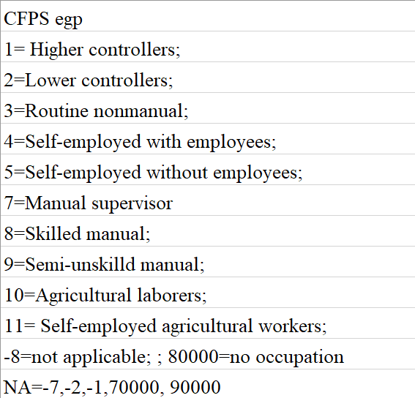
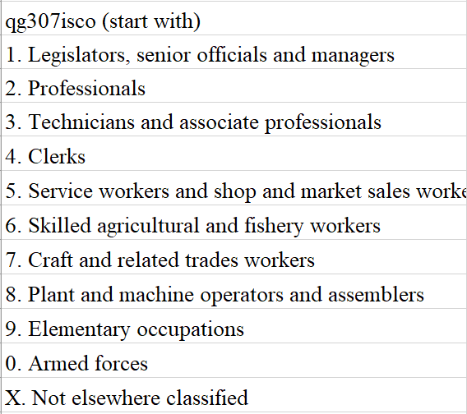
职业
CFPS
EGP （成人问卷egp）
因此只有儿童有父母的该变量egp_f, egp_m
Hollingshead某一版使用了该变量，遇到该算法时可以注意是否能够配对
遇到职业分为~10类的情况可以看一看是否能和这个变量对上
ISCO-88（成人问卷qg307isco）
同样只有儿童有父母的该变量
非常复杂的职业系统（超过几百种职业）
每个职业有一个四个数字的编码
可以根据第一个数字进行粗略分类
尚未使用过的变量（在文献中如果出现可以尝试复现）
CSCO-国家标准职业分类（中国）
ISCO转换的两个编码：
国际标准职业社会经济指数(ISEI）
标准国际职业声望量表（SIOPS）

Slide 8
职业
PSID:
4-digit 2010 Census Occupation Codes and Industry code (occupation_code, industry_code)
尚未遇到可以使用该编码的文献
如果文中说明和US census相关可以尝试

Slide 9
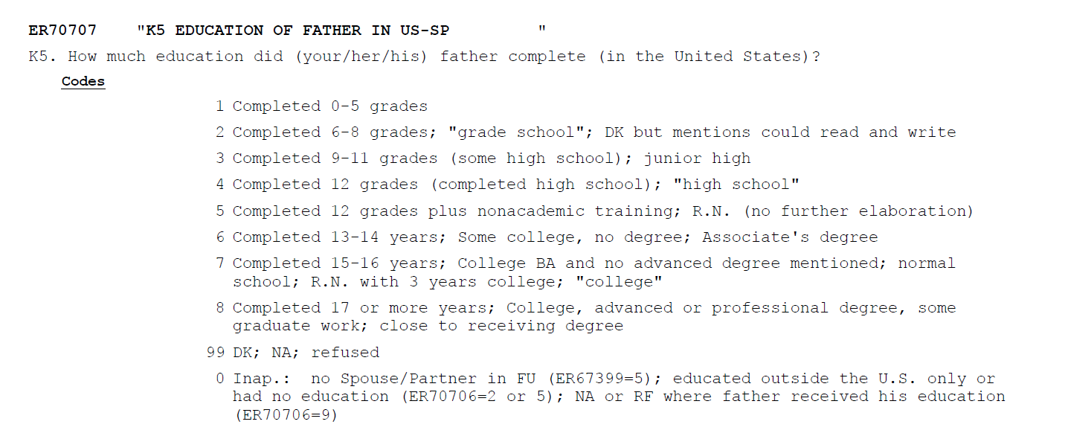

Slide 10
主观社会经济地位SSS
CFPS: 成年人问卷 Social status in local area [1 = very poor -----5 = very high]
成年人:自己的SSS(sss),部分成年人有父母的sss (sss_f, sss_m)
儿童:部分儿童有自己的SSS(有成年人问卷, sss_c), 大部分儿童有父母的SSS (sss_f, sss_m)
PSID: 只有reference person/spouse有该变量(sss_rp, sss_sp) K37. Were (your/Spouse's/Partner's) parents poor when (you were/[she/he] was) growing up, pretty well off or what? [1 = Poor 3 = Average; "it varied” 5 = Pretty well off 9 = DK; NA; refused 0 = Inap]
成年人: 自己的SSS (sss),部分成年人有父母的sss (sss_f, sss_m)
儿童: 父母的SSS (sss_f, sss_m), 部分儿童有自己的SSS(sss_c) [更正]

Slide 11
关于income国家/年份之间转换问题
例如：文献2020年美国$10000以上为高收入组，$10000以下为低收入组
不同国家（同一年份）：购买力
Purchasing power parity (PPP) is a measurement of the price of specific goods in different countries and is used to compare the absolute purchasing power of the countries' currencies
For example, if a computer was 1000 US dollars in New York and the same the exactly same computer cost 6000 HK dollars in Hong Kong, the PPP exchange rate would be 6 HK dollars for every 1 US dollar.
Data from: https://data.oecd.org/conversion/purchasing-power-parities-ppp.htm#indicator-chart

Slide 12
关于income国家/年份之间转换问题
不同年份（同一国家）通货膨胀之间的转换：Consumer price index CPI
The Consumer Price Index measures the overall change in consumer prices based on a representative basket of goods and services over time.
Data from: https://data.worldbank.org/indicator/FP.CPI.TOTL?locations=US (有不同国家的数据）

Slide 13
拟采用的转换方式
例如：文献2020年美国$10000以上为高收入组，$10000以下为低收入组
CFPS:需要转换为2010年人民币
2020 美元→ 2020 人民币 (使用PPP)
2020 人民币→ 2010 人民币 (使用CPI)
PSID:需要转化为2017年美元
2020美元→2017美元(使用CPI)

Slide 14
Codebook (SES variables only)
df.CFPS_child
df.CFPS_adult
df.CFPS_elderly
df.PSID_child
df.PSID_adult
df.PSID_elderly

Slide 15
df.CFPS_child (age between 10-22)
 | Children | Father | Mother | Note
education | edu_c | edu_f | edu_m | Categorical
 | eduy_c | eduy_f | eduy_m | Continuous
Income | income_c | income_f | income_m | Personal income
 | faminc | faminc | faminc | family income
Occupation | egp_c | egp_f | egp_m | egp occupation coding
 | isco_c | isco_f | isco_m | isco occupation coding
Subjective SES | sss_c | sss_f | sss_m
House ownership | housing | housing | housing | 1 = "Property right solely owned by the family" 2 = "Joint property right with work unit(danwei)" 3 = "Rented" 4 = "Provided by the government for free" 5 = "Provided by work unit(danwei) for free"6 = "Provided by parents/children" 7 = "Borrowed from friends or relatives" 77 = "Other [Please specify]"
Employment | employment_c | employment_f | employment_m | 0 = not employed; 1 = employed

Slide 16
df.CFPS_adult (age >22)
 | Self | Father | Mother | Note
education | edu | edu_f | edu_m | Categorical
 | eduy | eduy_f | eduy_m | Continuous
Income | income | income_f | income_m | Personal income
 | faminc | faminc | faminc | family income
Occupation | egp | egp_f | egp_m | egp occupation coding
 | isco | isco_f | isco_m | isco occupation coding
Subjective SES | sss | sss_f | sss_m
House ownership | housing | housing | housing | 1 = "Property right solely owned by the family" 2 = "Joint property right with work unit(danwei)" 3 = "Rented" 4 = "Provided by the government for free" 5 = "Provided by work unit(danwei) for free"6 = "Provided by parents/children" 7 = "Borrowed from friends or relatives" 77 = "Other [Please specify]"
Employment | employment | employment_f | employment_m | 0 = not employed; 1 = employed

Slide 17
df.CFPS_elderly (age >60) [Same as df.CFPS_adult but parents’ data is very incomplete]
 | Self | Father | Mother | Note
education | edu | edu_f | edu_m | Categorical
 | eduy | eduy_f | eduy_m | Continuous
Income | income | income_f | income_m | Personal income
 | faminc | faminc | faminc | family income
Occupation | egp | egp_f | egp_m | egp occupation coding
 | isco | isco_f | isco_m | isco occupation coding
Subjective SES | sss | sss_f | sss_m
House ownership | housing | housing | housing | 1 = "Property right solely owned by the family" 2 = "Joint property right with work unit(danwei)" 3 = "Rented" 4 = "Provided by the government for free" 5 = "Provided by work unit(danwei) for free"6 = "Provided by parents/children" 7 = "Borrowed from friends or relatives" 77 = "Other [Please specify]"
Employment | employment | employment_f | employment_m | 0 = not employed; 1 = employed

Slide 18
df.PSID_child (age between 10-22)
 | Children | Father | Mother | Note
education | / | edu_f | edu_m | Categorical
 | eduy_c | eduy_f | eduy_m | Continuous
Income | income_c | income_f | income_m | Personal income
 | fincome | fincome | fincome | family income
Occupation | occupation_code_c | occupation_code_f | occupation_code_m | occupation coding
 | industry_code_c | industry_code_f | industry_code_m | industry coding
Subjective SES | sss_c | sss_f | sss_m
House ownership | housing | housing | housing | 0, rent or neither rent or own; 1-9999997, actual value of the owned house; 9999998, DK; 9999999, refuse to answer
Employment | employment_c | employment_f | employment_m | 1= working; 2= Only temporarily laid off; 3-8 = not employed; 9 = DK/NA; 0 = not applicable

Slide 19
df.PSID_adult (age >22)
 | Self | Father | Mother | Note
education | / | edu_f | edu_m | Categorical
 | eduy | eduy_f | eduy_m | Continuous
Income | income | income_f | income_m | Personal income
 | fincome | fincome | fincome | family income
Occupation | occupation_code | occupation_code_f | occupation_code_m | occupation coding
 | industry_code | industry_code_f | industry_code_m | industry coding
Subjective SES | sss | sss_f | sss_m
House ownership | housing | housing | housing | 0, rent or neither rent or own; 1-9999997, actual value of the owned house; 9999998, DK; 9999999, refuse to answer
Employment | employment | employment_f | employment_m | 1= working; 2= Only temporarily laid off; 3-8 = not employed; 9 = DK/NA; 0 = not applicable

Slide 20
df.PSID_elderly (age >60) [Same as df.PSID_adult but parents’ data is very incomplete]
 | Self | Father | Mother | Note
education | / | edu_f | edu_m | Categorical
 | eduy | eduy_f | eduy_m | Continuous
Income | income | income_f | income_m | Personal income
 | fincome | fincome | fincome | family income
Occupation | occupation_code | occupation_code_f | occupation_code_m | occupation coding
 | industry_code | industry_code_f | industry_code_m | industry coding
Subjective SES | sss | sss_f | sss_m
House ownership | housing | housing | housing | 0, rent or neither rent or own; 1-9999997, actual value of the owned house; 9999998, DK; 9999999, refuse to answer
Employment | employment_c | employment_f | employment_m | 1= working; 2= Only temporarily laid off; 3-8 = not employed; 9 = DK/NA; 0 = not applicable

